Slide 1
Support Vector Machines
David Quigley
CSCI 5622
2021 Fall

Slide 2

Course Logistics
Project Pitch Feedback – Did you get your Projects to Review?
Exam 1 – October 20th
Problem Set 3 – Due October 25*
It still hasn’t quite been released, so the due date will need to be adjusted
This will impact the project milestone 3 deadline (which is tiny, but still don’t want a 0 - 3 day gap)
This will probably only minorly impact “Problem Set 4”
It’s going to be a very different kind of activity

Slide 3
Classification – Weeks 1 – 7*
K Nearest Neighbors
Manhattan, Euclidian Distance
Naïve Bayes
Class-Conditional, Prior, Evidence
Trees & Ensemble Methods
Splitting, Pruning
Random Forests
AdaBoost
Logistic Regression
Idea, Proof, Implementation
Gradient Descent
Stochastic & Mini-Batch Gradient Descent
SVM
Idea, Proof, Implementation
Sequential Minimal Optimizer
Kernel Trick

Slide 4
Regression
Linear Regression
Idea, Proof, Implementation
Minimizing MSE / LSS

Slide 5
Dimensionality Reduction
Select-K-Best / Best Subset
Stepwise selection
Stagewise Selection
Lasso & Ridge Regression
Idea, Proof, Implementation
Within Linear Regression

Slide 6
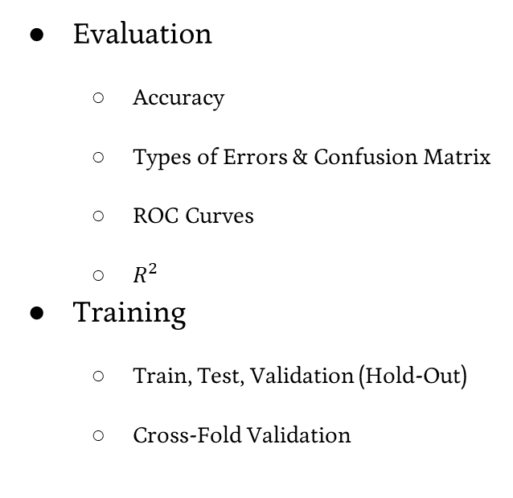
Skills
Evaluation
Accuracy
Types of Errors & Confusion Matrix
ROC Curves
$R^{2}$
Training
Train, Test, Validation (Hold-Out)
Cross-Fold Validation
Multi-Class
One vs. All
All-Pairs (One vs. Another)
Data Transformation
Encoding, Binning, Smoothing, Binarization / One-Hot Encoding, etc.
Scaling & Normalization
Min-Max, Mean & Std. Dev

Slide 7
Concerns
Impact of Errors
False Positive vs. False Negative
Overfitting
High Variance
Underfitting
High Bias
Curse of Dimensionality
When to use what classifiers?

Slide 8

Exam 1 - Logistics
Delivered via Canvas
Open on Oct. 20, Approximately all day
(Probably not 12:01AM to 11:59PM, but well beyond the class period, including morning through evening times)
It will be Timed to only allow you 50 minutes to complete
Those with 1.5X dispensation, etc. will be accommodated via Canvas.
Exam support will be provided in-lecture and via Zoom during lecture time.
A slightly longer window of support (i.e. to accommodate extra time students) will be via Zoom, timing TBD.

Slide 9

Exam 1 - Format
It is considered “open-resources”, but “individual”
Previous work, notes, Piazza discussions, textbook, etc. are all fair game
(Piazza will be in “read-only” mode for the day, so don’t be scared someone will post solutions there)
In general, follow the same plagiarism and honor code policies as any other assignment
Conceptual Questions
Closed-ended (multiple choice, matching, word bank, etc.)
Open-ended short answer with clear guidance (name one reason we would choose X over Y)
Problem Solving
Can be done with a 4-function calculator and some paper in a 50-minute exam
No coding or code analysis

Slide 10
Continued Milestone 2 Videos
19
20
21
22
23
24
26
27
0
10

Slide 11
Best Decision Boundary
argmax_{w, b} (1 / ||w||) such that y_{i}(w^{T}x_{i} + b) >= 1 for i = {1,2,…,m}
Optimize to find w, b

Slide 12
Best Decision Boundary
argmax_{w, b} (1 / ||w||) such that y_{i}(w^{T}x_{i} + b) >= 1 for i = {1,2,…,m}
Optimize to find w, b
But it’s not differentiable! (i.e. we can’t find a gradient vector)

Slide 13
Best Decision Boundary
argmax_{w, b} (1 / ||w||) such that y_{i}(w^{T}x_{i} + b) >= 1 for i = {1,2,…,m}
Not Differentiable
argmin_{w, b} (||w||) such that y_{i}(w^{T}x_{i} + b) >= 1 for i = {1,2,…,m}

Slide 14
Best Decision Boundary
argmax_{w, b} (1 / ||w||) such that y_{i}(w^{T}x_{i} + b) >= 1 for i = {1,2,…,m}
Not Differentiable
argmin_{w, b} (||w||) such that y_{i}(w^{T}x_{i} + b) >= 1 for i = {1,2,…,m}
Not Differentiable

Slide 15
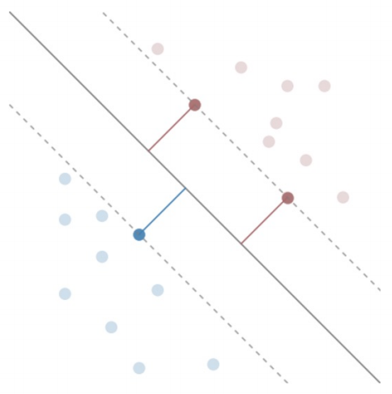
Best Decision Boundary
Support Vectors
w^{T}x + b = ± 1
DB is unaffected by scale
(2w)^{T}x + 2b = 0

Slide 16

Best Decision Boundary
argmax_{w, b} (1 / ||w||) such that y_{i}(w^{T}x_{i} + b) >= 1 for i = {1,2,…,m}
Not Differentiable
argmin_{w, b} (||w||) such that y_{i}(w^{T}x_{i} + b) >= 1 for i = {1,2,…,m}
Not Differentiable
argmin_{w, b} (||w||²) such that y_{i}(w^{T}x_{i} + b) >= 1 for i = {1,2,…,m}
Convex + Differentiable
Requires a Convex quadratic program

Slide 17
Underlying Math – Finding our Maximum Margin

Slide 18
Generalizing – adding Lagrange Multipliers
min_{w} f(w) such that g_{i}(w) <= 0 for i = {1,2,…,m}

Slide 19
Generalizing – adding Lagrange Multipliers
min_{w} f(w)
such that g_{i}(w) <= 0 for i = {1,2,…,m}
The Lagrangian of this function
L(w, α) = f(w) + ∑_{i=1…m} (α_{i}g_{i}(w))
such that α_{i} >= 0

Slide 20
Generalizing – adding Lagrange Multipliers
min_{w} f(w)
such that g_{i}(w) <= 0 for i = {1,2,…,m}
The Lagrangian of this function
L(w, α) = f(w) + ∑_{i=1…m} (α_{i}g_{i}(w))
such that α_{i} >= 0
Max_{α} L(w, α) = f(w)*
* Holds if f(w) is feasible, otherwise it goes to infinity

Slide 21
Generalizing – adding Lagrange Multipliers
min_{w} max_{α} L(w, α) = min_{w} max_{α} f(w) + ∑_{i=1…m} (α_{i}g_{i}(w))
such that α_{i} >= 0
Problem is convex
Global minimum means
∇_{w} L(w, α) = 0 and ∇_{α} L(w, α) = 0

Slide 22
Generalizing – adding Lagrange Multipliers
min_{w} max_{α} L(w, α) = min_{w} max_{α} f(w) + ∑_{i=1…m} (α_{i}g_{i}(w))
such that α_{i} >= 0
Problem is convex
Global minimum means
∇_{w} L(w, α) = 0 and ∇_{α} L(w, α) = 0
min_{w} f(w)
such that g_{i}(w) <= 0 for i = {1,2,…,m}

Slide 23
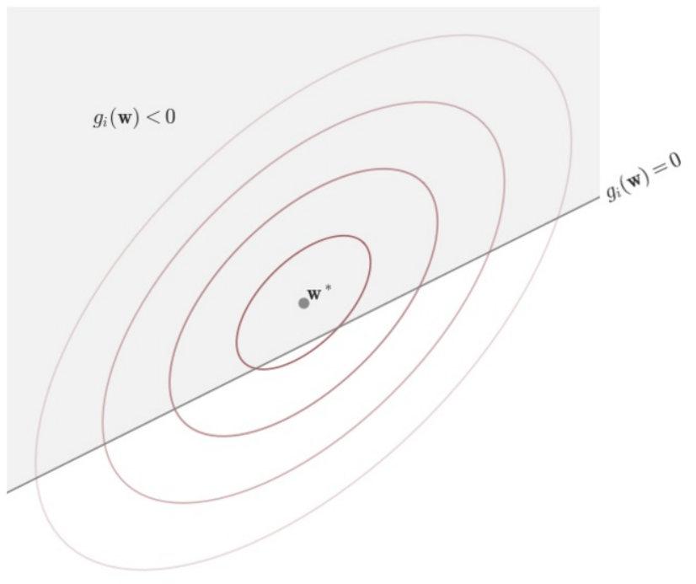

Visualizing f(x) and g(x)

Slide 24
Visualizing f(x) and g(x)
f(x) is minimized within the g_{i}(x) constraint, g_{i}(x) is inactive
we can “ignore” our α, α_{i} = 0
∇_{w} f(w) = 0

Slide 25
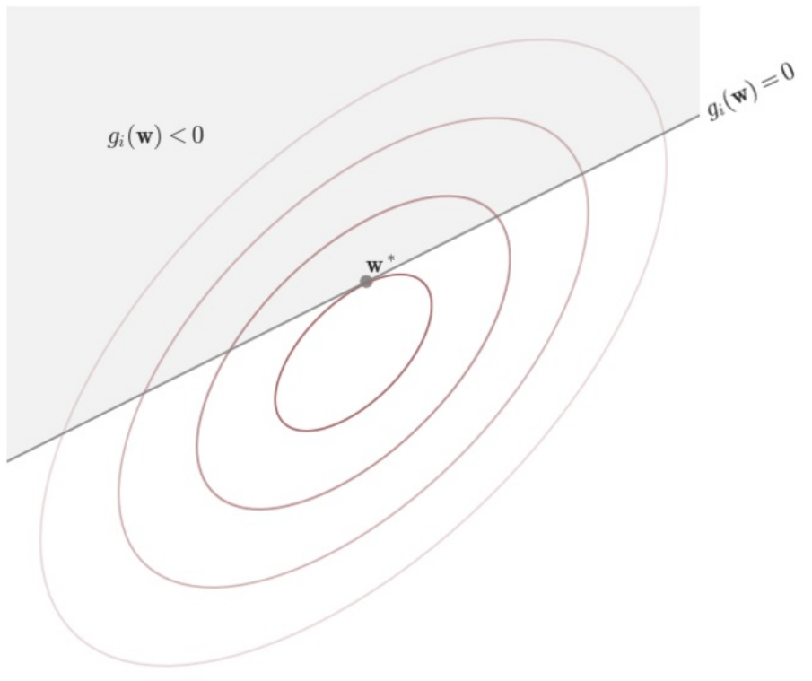
Visualizing f(x) and g(x)
f(x) is not minimized within the g_{i}(x) constraint, g_{i}(x) is active
α_{i} > 0

Slide 26
Complementary Slackness
α_{i}g_{i}(w*) = 0 for I = {1,2,…,m}
if α_{i} = 0 if we are not on the boundary of g_{i}
else α_{i} > 0

Slide 27

The Dual Formulation
min_{w} max_{α} L(w, α)
such that α_{i}g_{i}(w) = 0
and α_{i} >= 0
max_{α} min_{w} L(w, α) <= min_{w} max_{α} L(w, α)
DUAL PRIMAL

Slide 28

Our New Formulation
argmin_{w, b} (||w||²) such that y_{i}(w^{T}x_{i} + b) >= 1 for i = {1,2,…,m}
min_{w} max_{α} L(w, α) = min_{w} max_{α} f(w) + ∑_{i=1…m} (α_{i}g_{i}(w)) - PRIMAL
Becomes
L_{D} = max_{α} min_{w,b} (½||w||² + ∑_{i=1…m} (α_{i} (1 – y_{i}(w^{T}x_{i} + b))))
DUAL

Slide 29
Lagragian Form of Maximizing the Margin
L_{D} = max_{α} min_{w,b} (½||w||² + ∑_{i=1…m} (α_{i} (1 – y_{i}(w^{T}x_{i} + b))))
We want the derivative of w & b to be 0
Now that min_{w,b} is the inner optimization, we can do this!
w = ∑_{i} α_{i} y_{i} x_{i}
0 = ∑_{i} α_{i} y_{i}

Slide 30
Lagragian Form of Maximizing the Margin
L_{D} = max_{α} min_{w,b} (½||w||² + ∑_{i=1…m} (α_{i} (1 – y_{i}(w^{T}x_{i} + b))))
Apply complementary slackness & set derivative w, b to 0
Karush-Kuhn-Tucker Conditions
max_{α} (L_{D}) = max_{α} (∑_{i} α_{i} − ½ ∑_{i,j} α_{i} α_{j} y_{i} y_{j} x_{i} · x_{j})
α_{i} > 0 if y_{i}(w^{T}x_{i} + b) = 1
α_{i} = 0 if y_{i}(w^{T}x_{i} + b) < 1

Slide 31

Maximizing our Margin
max_{α} (∑_{i} α_{i} − ½ ∑_{i,j} α_{i} α_{j} y_{i} y_{j} x_{i} · x_{j})
α_{i} > 0 if y_{i}(w^{T}x_{i} + b) = 1
α_{i} = 0 if y_{i}(w^{T}x_{i} + b) < 1

Slide 32
Thursday

Slide 33
Course Logistics
Project Pitch Feedback – Did you get your Projects to Review?
Exam 1 – October 21st
Just released a “Practice Exam” that should show off the formatting, etc.
Problem Set 3 – Due November 2

Slide 34
Participation: Exam 1 Review Poll

Slide 35
Best Decision Boundary
argmax_{w, b} (1 / ||w||) such that y_{i}(w^{T}x_{i} + b) >= 1 for i = {1,2,…,m}
Not Differentiable
argmin_{w, b} (||w||) such that y_{i}(w^{T}x_{i} + b) >= 1 for i = {1,2,…,m}
Not Differentiable
argmin_{w, b} (||w||²) such that y_{i}(w^{T}x_{i} + b) >= 1 for i = {1,2,…,m}
Convex + Differentiable
Requires a Convex quadratic program

Slide 36
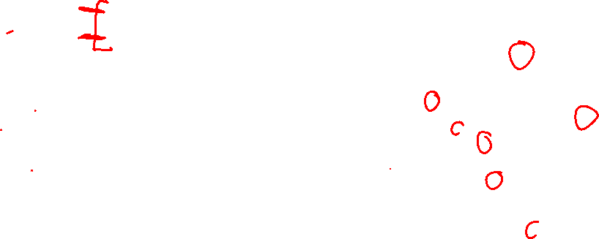
Maximizing our Margin
max_{α} (∑_{i} α_{i} − ½ ∑_{i,j} α_{i} α_{j} y_{i} y_{j} x_{i} · x_{j})
α_{i} > 0 if y_{i}(w^{T}x_{i} + b) = 1
α_{i} = 0 if y_{i}(w^{T}x_{i} + b) < 1

Slide 37
Maximizing our Margin
max_{α} (∑_{i} α_{i} − ½ ∑_{i,j} α_{i} α_{j} y_{i} y_{j} x_{i} · x_{j})
α_{i} > 0 if y_{i}(w^{T}x_{i} + b) = 1
α_{i} = 0 if y_{i}(w^{T}x_{i} + b) < 1
Most of these points (all the greyed out ones)
Are 0!
- They have no impact on what we are
maximizing…

Slide 38
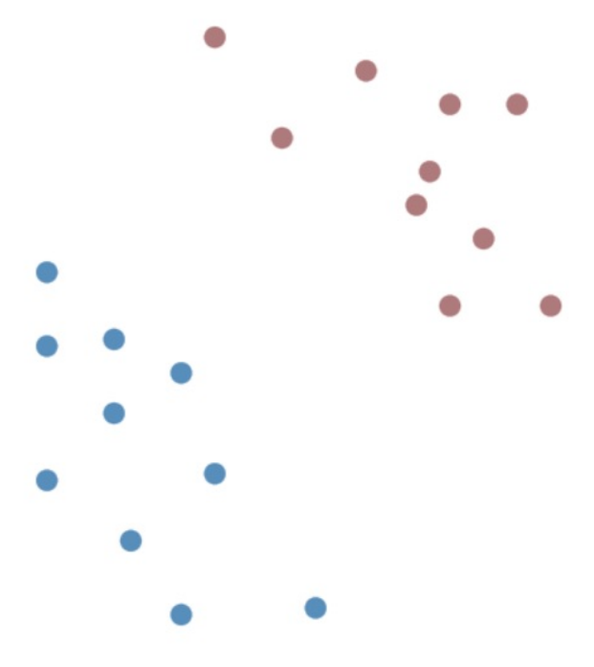

A Less Good Margin
max_{α} (∑_{i} α_{i} − ½ ∑_{i,j} α_{i} α_{j} y_{i} y_{j} x_{i} · x_{j})
α_{i} > 0 if y_{i}(w^{T}x_{i} + b) = 1
α_{i} = 0 if y_{i}(w^{T}x_{i} + b) < 1

Slide 39
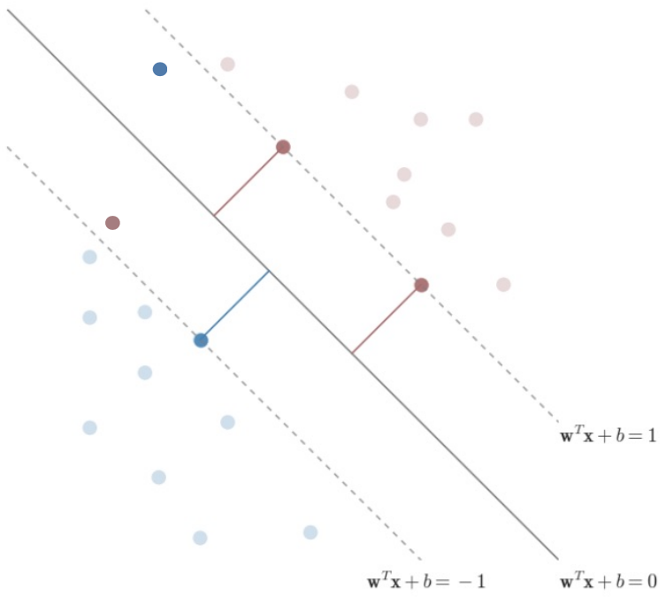
Shortcomings of Hard-Margin SVM
What if Linear Separability does not apply?

Slide 40
Interlude - Soft-Margin SVMs

Slide 41
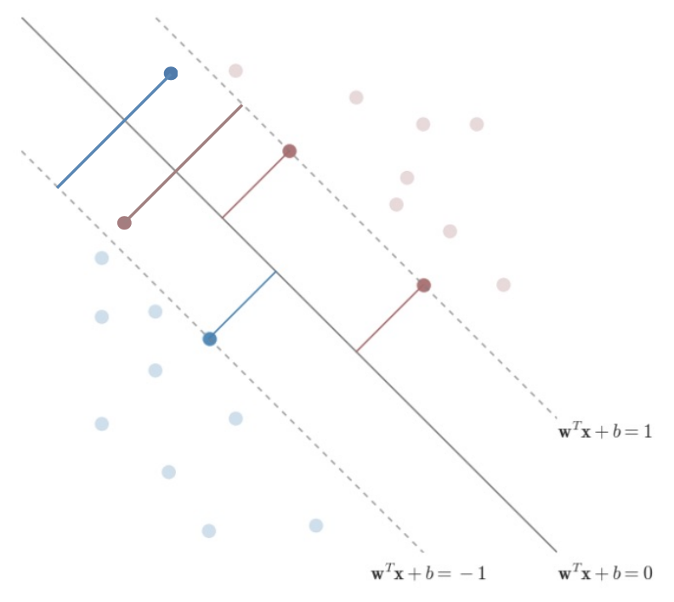

Overcoming Linear Separability Problem
Add some wiggle room to our
problem space

Slide 42
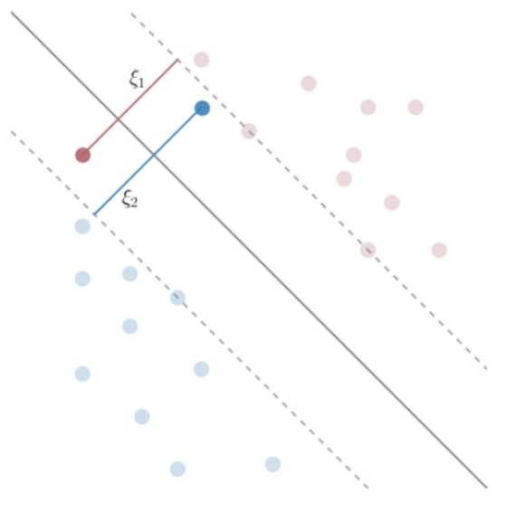
Adding a slack term ξ
Add a slack term ξ to every example
(for most examples the ξ is 0)

Slide 43
Adding a slack term ξ – Objective Function
argmin_{w, b} (½||w||²) → argmin_{w, b} (½||w||²) + C ∑_{i=1→m} ξ_{i}^{p}
C = Tuning Parameter
p = scaling of wrongness
p = 1 is often used

Slide 44

Adding a slack term ξ - Constraints
y_{i}(w^{T}x_{i} + b) >= 1 → y_{i}(w^{T}x_{i} + b) >= 1 – ξ_{i}
ξ_{i} relates to distance from the correct margin
ξ_{i} = 0 when we are on the correct side
(or on the boundary) of our margin
ξ_{i} = ½ when we are halfway between margin
and decision boundary
ξ_{i} = 2 when we are 1 margin on the wrong
side of the decision boundary

Slide 45
Adding a slack term ξ - Lagrangian
L(w,b,α) = (½||w||² + ∑_{i=1…m} (α_{i} (1 – y_{i}(w^{T}x_{i} + b)))) →
L(w,b,α,ξ)= (½||w||² - ∑_{i=1…m} (α_{i} (y_{i}(w^{T}x_{i} + b) – 1 + ξ_{i}))) - ∑_{i=1…m} β_{i}ξ_{i}
Add ξ as a term to minimize…

Slide 46
Adding a slack term ξ - Lagrangian
L(w,b,α) = (½||w||² + ∑_{i=1…m} (α_{i} (1 – y_{i}(w^{T}x_{i} + b)))) →
L(w,b,α,ξ)=(½||w||² - ∑_{i=1…m} (α_{i} (y_{i}(w^{T}x_{i} + b) – 1 + ξ_{i}))) - ∑_{i=1…m} β_{i}ξ_{i}
Add ξ as a term to minimize…
----------------------------------- Magic Happens -------------------------------------
max_{α} (∑_{i} α_{i} − ½ ∑_{i,j} α_{i} α_{j} y_{i} y_{j} x_{i} · x_{j}) – unchanged
New constraint: 0 <= α <= C

Slide 47
Adding a slack term ξ – Final Form
max_{α} (L_{D}) = max_{α} (∑_{i} α_{i} − ½ ∑_{i,j} α_{i} α_{j} y_{i} y_{j} x_{i} · x_{j})
α_{i} = C if y_{i}(w^{T}x_{i} + b) < 1
C > α_{i} > 0 if y_{i}(w^{T}x_{i} + b) = 1
α_{i} = 0 if y_{i}(w^{T}x_{i} + b) > 1

Slide 48
Maximizing our Margin
max_{α} (∑_{i} α_{i} − ½ ∑_{i,j} α_{i} α_{j} y_{i} y_{j} x_{i} · x_{j})
α_{i} > 0 if y_{i}(w^{T}x_{i} + b) = 1
α_{i} = 0 if y_{i}(w^{T}x_{i} + b) < 1

Slide 49
(Finally) Calculating our Maximum

Slide 50
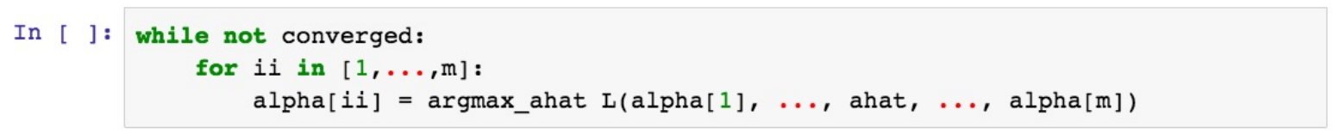
Coordinate Ascent
L(α_{i=1→m}) = (∑_{i} α_{i} − ½ ∑_{i,j} α_{i} α_{j} y_{i} y_{j} x_{i} · x_{j})
Change α_{i} to make L(α) as big as possible

Slide 51
Coordinate Ascent
L(α_{i=1→m}) = (∑_{i} α_{i} − ½ ∑_{i,j} α_{i} α_{j} y_{i} y_{j} x_{i} · x_{j})
Change α_{i} to make L(α) as big as possible
0 = ∑_{i=1→m} α_{i} y_{i}
We can’t change α_{i} one at a time!

Slide 52
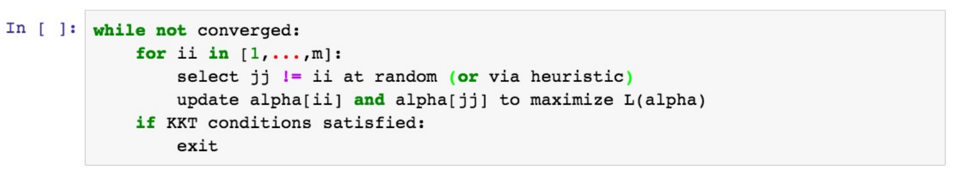

Sequential Minimal Optimizer
L(α_{i=1→m}) = (∑_{i} α_{i} − ½ ∑_{i,j} α_{i} α_{j} y_{i} y_{j} x_{i} · x_{j})
Change α_{i}, α_{j} to make L(α) as big as possible
0 = ∑_{i=1→m} α_{i} y_{i}

Slide 53
Sequential Minimal Optimizer
Change α_{i}, α_{j} to make L(α) as big as possible
0 = ∑_{i=1→m} α_{i} y_{i}
0 = α₁ y₁ + α₂ y₂ + ∑_{k=3→m} α_{k} y_{k}

Slide 54
Sequential Minimal Optimizer
Change α_{i}, α_{j} to make L(α) as big as possible
0 = ∑_{i=1→m} α_{i} y_{i}
0 = α₁ y₁ + α₂ y₂ + ∑_{k=3→m} α_{k} y_{k}
α_{i} y_{i} + α_{j} y_{j} = - ∑_{k!=i,j} α_{k} y_{k} = δ

Slide 55
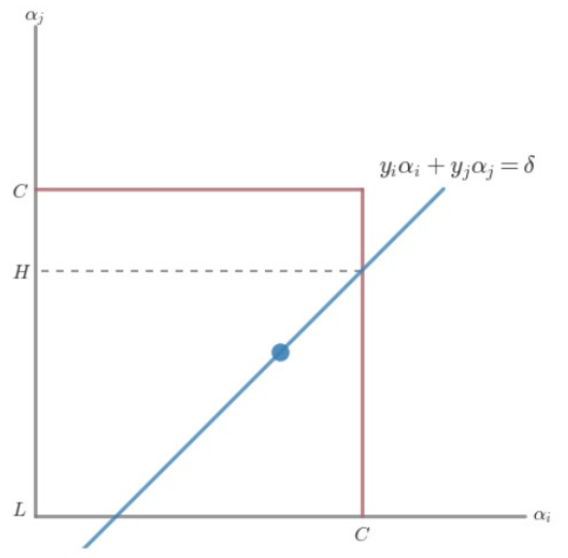
Sequential Minimal Optimizer
α_{i} y_{i} + α_{j} y_{j} = - ∑_{k!=i,j} α_{k} y_{k} = δ
0 <= α_{i} <= C

Slide 56

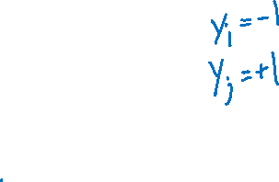
Sequential Minimal Optimizer
α_{i} y_{i} + α_{j} y_{j} = - ∑_{k!=i,j} α_{k} y_{k} = δ
0 <= α_{i} <= C
y_{i} != y_{j} y_{i} = y_{j}
L = max(0, α_{j} – α_{i}) or max(0, α_{j} + α_{i} – C)
H = min(C, C + α_{j} – α_{i}) or min(C, α_{j} + α_{i})

Slide 57
Sequential Minimal Optimizer
H if α_{j} > H
α_{j} = α_{j} if L <= α_{j} <= H
L if α_{j} < L
α_{i} such that α_{i} y_{i} + α_{j} y_{j} = - ∑_{k!=i,j} α_{k} y_{k} = δ

Slide 58
Sequential Minimal Optimizer
H if α_{j} > H
α_{j} = α_{j} if L <= α_{j} <= H
L if α_{j} < L
α_{i} such that α_{i} y_{i} + α_{j} y_{j} = - ∑_{k!=i,j} α_{k} y_{k} = δ

Slide 59
Shortcomings of Soft-Margin SVM
We added some wiggle room

Slide 60
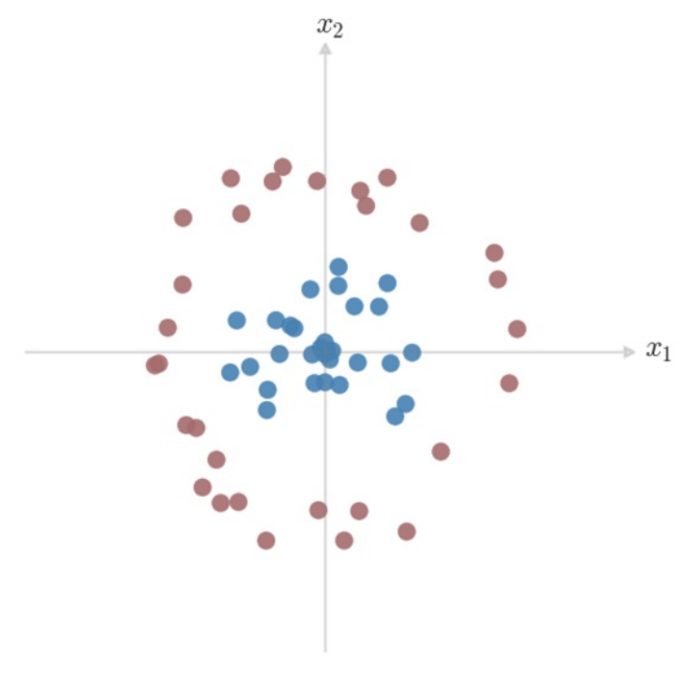

Shortcomings of Soft-Margin SVM
We added some wiggle room
But what if it’s not linearly separable?

Slide 61
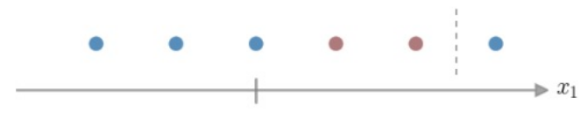
Linear Inseparability – 1D Case

Slide 62
Linear Inseparability – 1D Case
Your arterial blood’s pH should be between 7.35 and 7.45
Otherwise, you’re unhealthy (for some reason), we should run further tests.
https://www.maximumfun.org/sawbones/sawbones-alkaline-water
https://opentextbc.ca/anatomyandphysiology/chapter/26-5-disorders-of-acid-base-balance/

Slide 63
Linear Inseparability – 1D Case
What can we do to capture this idea?

Slide 64
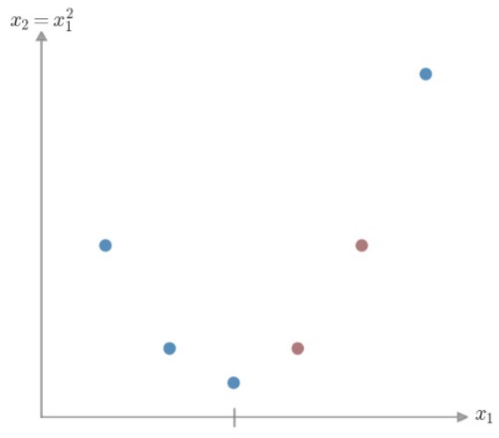

Linear Inseparability – 1D Case
Project our data into a higher dimensional space

Slide 65
Linear Inseparability – Dimension Projection
Start with our initial feature vector x = [x₁]
Create an augmented feature vector φ(x) = [x₁, x₁²]

Slide 66
Linear Inseparability – Dimension Projection
Start with our initial feature vector x = [x₁]
Create an augmented feature vector φ(x) = [x₁, x₁²]
Replace x with φ(x) in our optimization problem!

Slide 67
Our Optimization Problem
(∑_{i} α_{i} − ½ ∑_{i,j} α_{i} α_{j} y_{i} y_{j} x_{i} · x_{j})

Slide 68
Our Optimization Problem
(∑_{i} α_{i} − ½ ∑_{i,j} α_{i} α_{j} y_{i} y_{j} x_{i} · x_{j})
(∑_{i} α_{i} − ½ ∑_{i,j} α_{i} α_{j} y_{i} y_{j} φ(x)_{i} · φ(x)_{j})

Slide 69
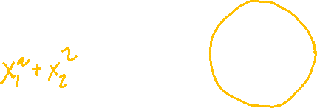
Dimension Projection
How would we separate these classes?

Slide 70
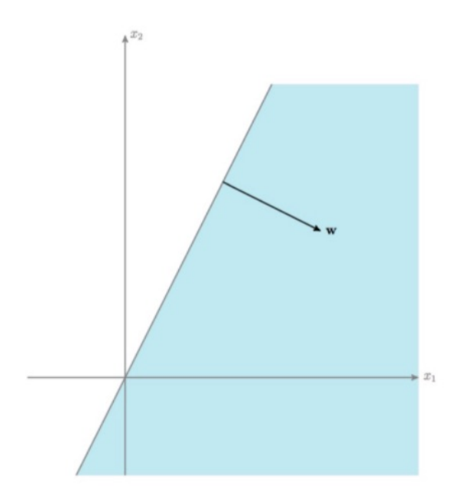
Dimension Projection - Circle
How would we separate these classes?
We think in terms of sides of a boundary…

Slide 71
Dimension Projection
How would we separate these classes?
What kind of boundary can we give
this space?
Can we express that boundary in
terms of our given features?

Slide 72
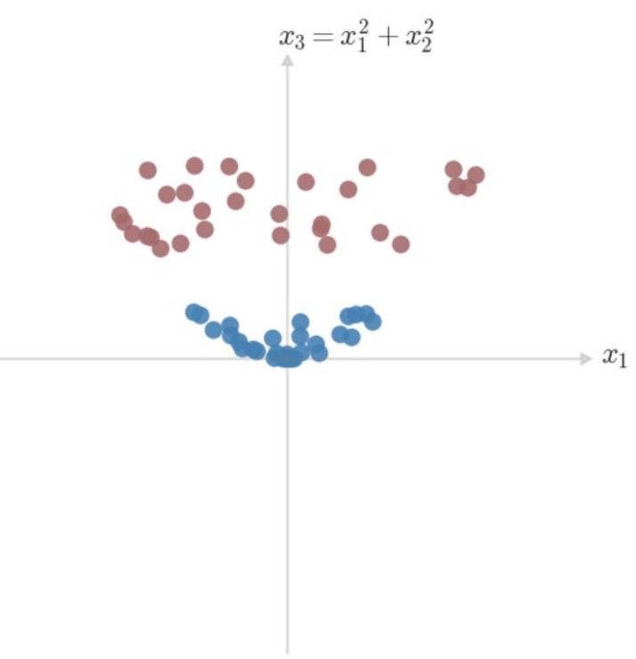

Dimension Projection
How would we separate these classes?
What kind of boundary can we give
this space?
Can we express that boundary in
terms of our given features?

Slide 73
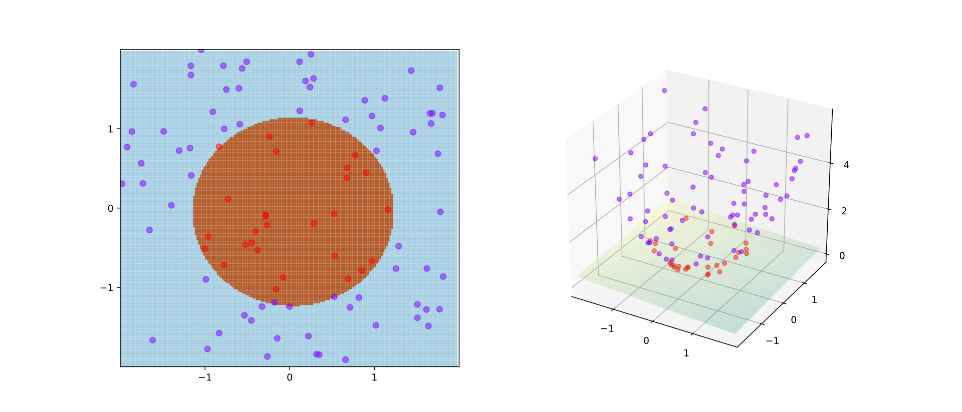
Dimension Projection - Circle
Notes:
https://en.wikipedia.org/wiki/Kernel_method#/media/File:Kernel_trick_idea.svg

Slide 74
Linear Inseparability – Dimension Projection
Start with our initial feature vector x = [x₁, x₂]
Create an augmented feature vector φ(x) = [x₁, x₂, x₁² + x₂²]
Replace x with φ(x) in our optimization problem!
Decision Boundary is a plane in 3D Space
x₁² + x₂² = constant

Slide 75
Our Optimization Problem
(∑_{i} α_{i} − ½ ∑_{i,j} α_{i} α_{j} y_{i} y_{j} x_{i} · x_{j})
(∑_{i} α_{i} − ½ ∑_{i,j} α_{i} α_{j} y_{i} y_{j} φ(x)_{i} · φ(x)_{j})

Slide 76
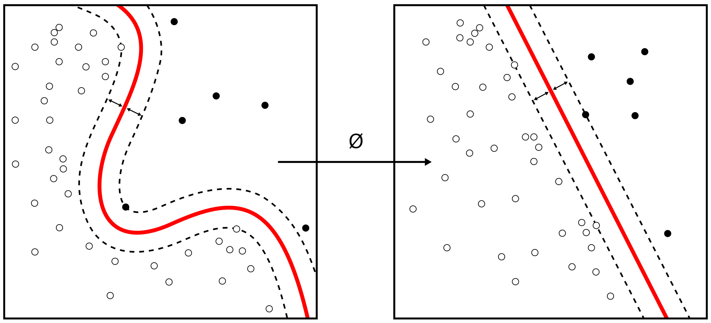

Generalizing our Optimization
Notes:
https://en.wikipedia.org/wiki/Kernel_method#/media/File:Kernel_Machine.svg

Slide 77

Our Optimization Problem – In Practice
For a 3-Dimensional Case…
X = [x₁,x₂,x₃]
φ(x) = (x_{i}^{T}x_{j})²

Slide 78
Linear Inseparability – 1D Case
Project our data into a higher dimensional space

Slide 79

Our Optimization Problem – In Practice
For a 3-Dimensional Case…
X = [x₁,x₂,x₃]
φ(x) = (x_{i}^{T}x_{j})²
φ[X] = [x₁ x₁, x₁ x₂, x₁ x₃, x₂ x₁, x₂ x₂, x₂ x₃, x₃ x₁, x₃ x₂, x₃ x₃]

Slide 80

Generalizing our Optimization – Curse of Dimensionality
Take a 64-feature vector
Transform it using φ(x) = (x_{i}^{T}x_{j})²
How many dimensions do I have?

Slide 81
Generalizing our Optimization – Curse of Dimensionality
Take a 64-feature vector
Transform it using φ(x) = (x_{i}^{T}x_{j})²
How many dimension do I have?
64^2 = 4096

Slide 82

Our Optimization Problem
(∑_{i} α_{i} − ½ ∑_{i,j} α_{i} α_{j} y_{i} y_{j} x_{i} · x_{j})
(∑_{i} α_{i} − ½ ∑_{i,j} α_{i} α_{j} y_{i} y_{j} φ(x)_{i} · φ(x)_{j})
Redefine φ(x)_{i} · φ(x)_{j} as K(x, z) (x_{i} becomes x, x_{j} becomes z)*
*there are restrictions on this mapping – we’ll get there!

Slide 83
Our Optimization Problem – In Practice
x, z are vectors of real numbers in N-Dimensional Space
K(x, z) = (x^{T}z)²

Slide 84
Our Optimization Problem – In Practice
x, z are vectors of real numbers in N-Dimensional Space
K(x, z) = (x^{T}z)²
K(x, z) = (∑_{i=1→n} (x_{i}z_{i})) (∑_{j=1→n} (x_{j}z_{j}))

Slide 85
Our Optimization Problem – In Practice
x, z are vectors of real numbers in N-Dimensional Space
K(x, z) = (x^{T}z)²
K(x, z) = (∑_{i=1→n} (x_{i}z_{i})) (∑_{j=1→n} (x_{j}z_{j}))
= ∑_{i=1→n} ∑_{j=1→n}(x_{i}z_{i}x_{j}z_{j})
= ∑_{i,j=1→n}(x_{i}z_{i}x_{j}z_{j})
(∑_{i} α_{i} − ½ ∑_{i,j} α_{i} α_{j} y_{i} y_{j} (x_{i}z_{i}x_{j}z_{j}))

Slide 86
Kernels Save Time!
Computing φ(x) = (x_{i}^{T}x_{j})² takes O(n²)
Computing K(x,z) takes O(n)

Slide 87
Boundaries of Valid Kernels
For any set of points (x_{m}), you can store K(x_{i},x_{j}) in an m by m matrix K

Slide 88
Boundaries of Valid Kernels - Symmetry
For any set of points (x_{m}), you can store K(x_{i},x_{j}) in an m by m matrix K
K_{ij} = K(x^{i}) , x^{j} ) = φ(x^{i}))^{T} φ(x^{j}) = φ(x^{j})^{T} φ(x^{i}) = K(x^{j} , x^{i}) = K_{ji}
K must be symmetric

Slide 89
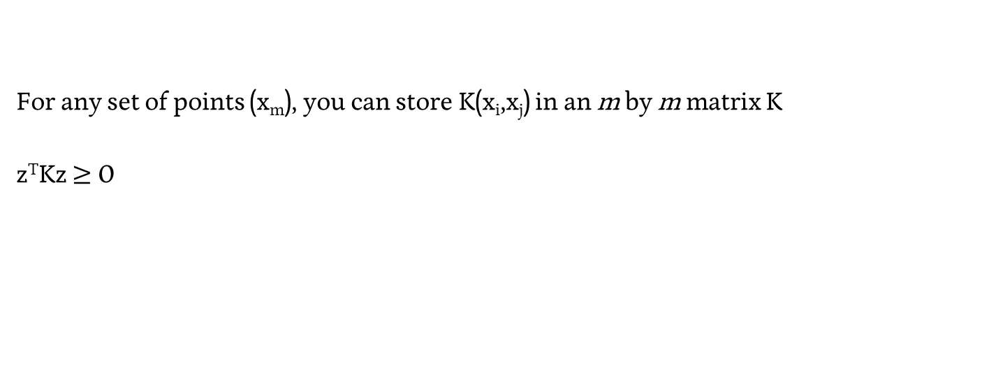
Boundaries of Valid Kernels – Positive Semi-Definite
For any set of points (x_{m}), you can store K(x_{i},x_{j}) in an m by m matrix K
z^{T}Kz $≥$ 0

Slide 90
Boundaries of Valid Kernels – Mercer’s Theorem
Theorem (Mercer). Let K : R^{n} × R^{n} → ℝ be given. Then for K to be a valid (Mercer) kernel, it is necessary and sufficient that for any {x¹, . . . , x^{m}}, (m < ∞), the corresponding kernel matrix is symmetric positive semi-definite.

Slide 91
Kernels Intuition
Dot product x · y tells you about the similarity between x and y
If both vectors are positive along a dimension, dot product will grow
If one vector is 0 along a dimension, dot product does not grow
If vectors are opposite signs along a dimension, dot product will shrink
Kernels just add dimension combinations to dot product!

Slide 92
Popular Kernels
Linear Kernel: K(x, z) = (x^{T}z)

Slide 93
Popular Kernels
Linear Kernel: K(x, z) = (x^{T}z)
Polynomial Kernel: K(x, z) = (x^{T}z + c)^{p}

Slide 94
Popular Kernels
Linear Kernel: K(x, z) = (x^{T}z)
Polynomial Kernel: K(x, z) = (x^{T}z + c)^{p}
Radial Basis Function(RBF) Kernel: K(x, z) = exp(- γ||x − z||²)

Slide 95
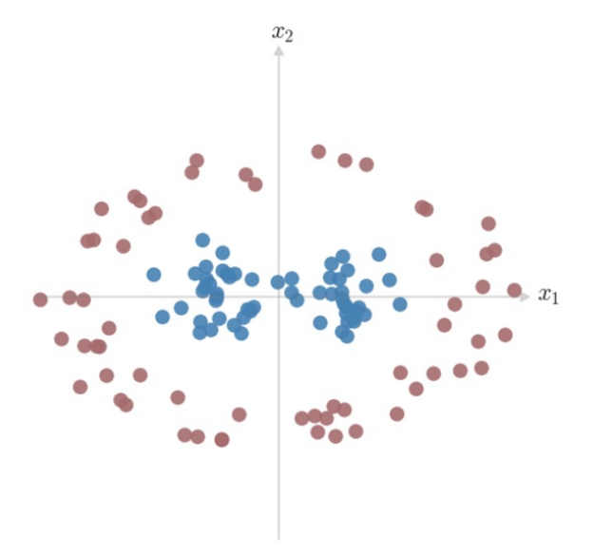
RBF Kernel for SVM

Slide 96
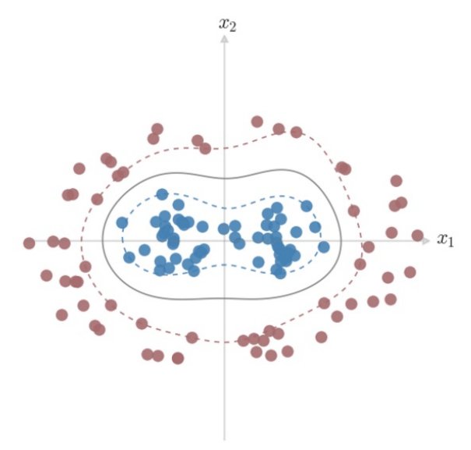
RBF Kernel for SVM
γ = 3
C = 5

Slide 97
Popular Kernels
Linear Kernel: K(x, z) = (x^{T}z)
Polynomial Kernel: K(x, z) = (x^{T}z + c)^{p}
Radial Basis Function(RBF) Kernel: K(x, z) = exp(- γ||x − z||²)
Gaussian RBF Kernel: K(x, z) = exp((- ||x − z||² ) / 2σ² )

Slide 98
SVM + Kernels
Pros
Works great “out-of-the-box”
Maintains convex objective function – guaranteed optimal solution
Solutions are sparse thanks to Kernels
Flexibly map to arbitrary decision boundary

Slide 99
SVM + Kernels
Pros
Works great “out-of-the-box”
Maintains convex objective function – guaranteed optimal solution
Solutions are sparse thanks to Kernels
Flexibly map to arbitrary decision boundary
Cons
Optimization can be slow
Choosing a Kernel is manual

Slide 100
Perceptrons

Slide 101
Linear Classification Task
w^{T}x + b → ± 1
If w^{T}x + b > 0, y = 1
If w^{T}x + b < 0, y = -1
w^{T}x + b = 0 is an edge case

Slide 102
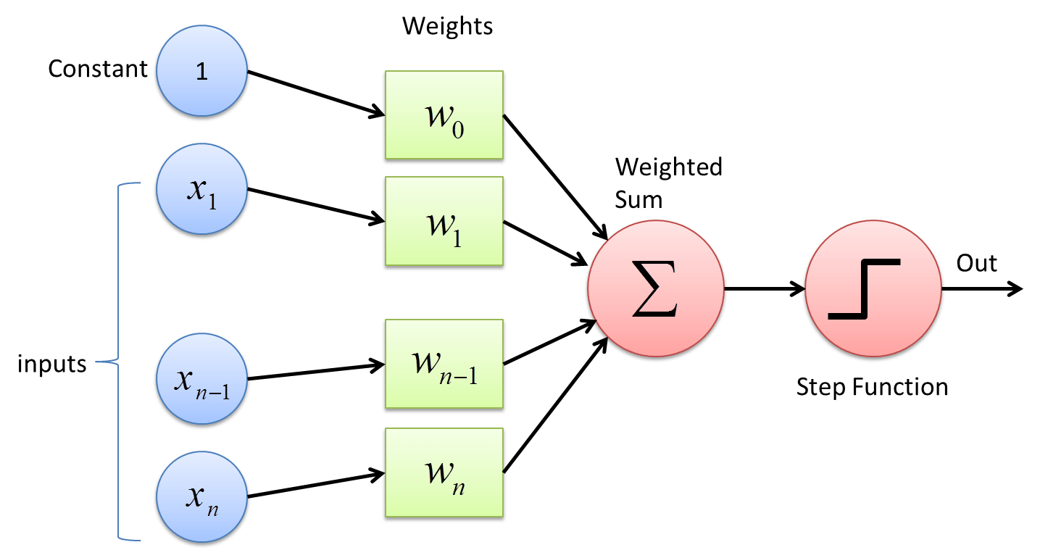
Visualizing Classification – The Perceptron
w^{T}x + b → ± 1
If w^{T}x + b > 0, y = 1
If w^{T}x + b < 0, y = -1
Notes:
https://cdn-images-1.medium.com/max/1600/1*n6sJ4yZQzwKL9wnF5wnVNg.png

Slide 103
Training a Perceptron – “Online” Learning
Initialize w to an all-zero vector.
For some fixed number of iterations, or until some stopping criterion is met:
For each training example xᵢ with ground truth label yᵢ ∈ {-1, 1}:
Let ŷ = sign(w^{T} xᵢ).
If ŷ ≠ yᵢ, update w ← w + yᵢ xᵢ.

Slide 104
Kernel Perceptron
Perform our Kernel transformation of our data, then generate our perceptron!

Slide 105
Kernel Perceptron
Create the matrix of our Kernel representation of our data
Linear Kernel: K(x, z) = (x^{T}z)
Polynomial Kernel: K(x, z) = (x^{T}z + c)^{p}
Radial Basis Function(RBF) Kernel: K(x, z) = exp(- γ||x − z||²)
Gaussian RBF Kernel: K(x, z) = exp((- ||x − z||² ) / 2σ² )

Slide 106
Training our Perceptron (Fit)
We no longer have “weights” to train on…

Slide 107
Training our Perceptron (Fit)
We no longer have “weights” to train on…
But we can use our Dual Expression of the problem!
∑_{i=1→n} α_{i}y_{i}K(x_{i},x_{j})
And use the same perceptron update as before, but increment our α by 1 each time.
If an example incremented α, then it’s a support vector

Slide 108
Interlude: Pros and Cons
When to use what classifiers

Slide 109


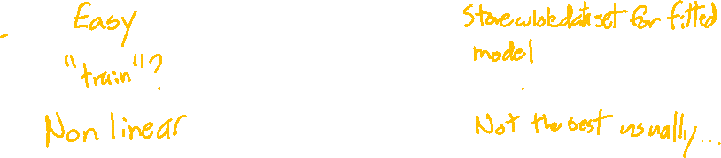
K-Nearest Neighbors
Pro
Con

Slide 110
K-Nearest Neighbors
Pro
Con (Ex)
Works with small N
Works for non-binary cases
Can be run without training
Doesn’t give much of a description of results beyond “similar to A, B, C…”
Has trouble with features at differing scales

Slide 111
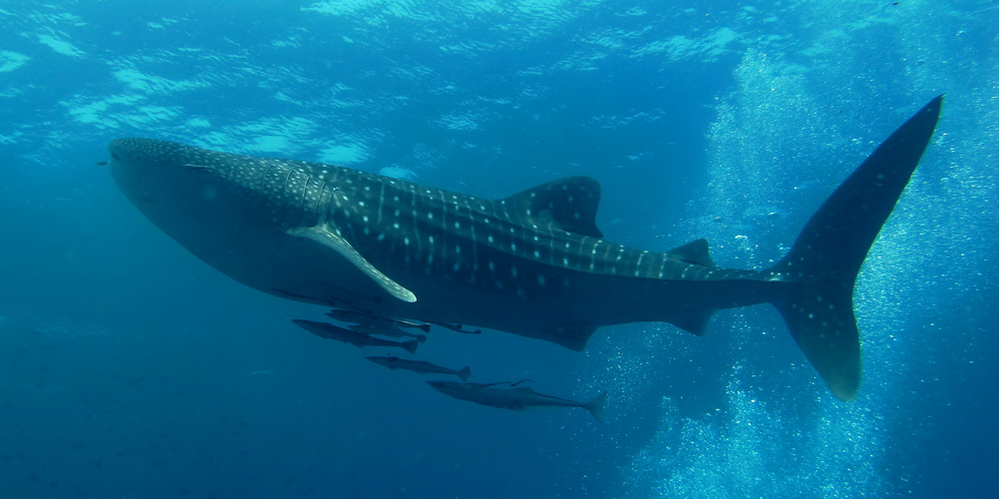
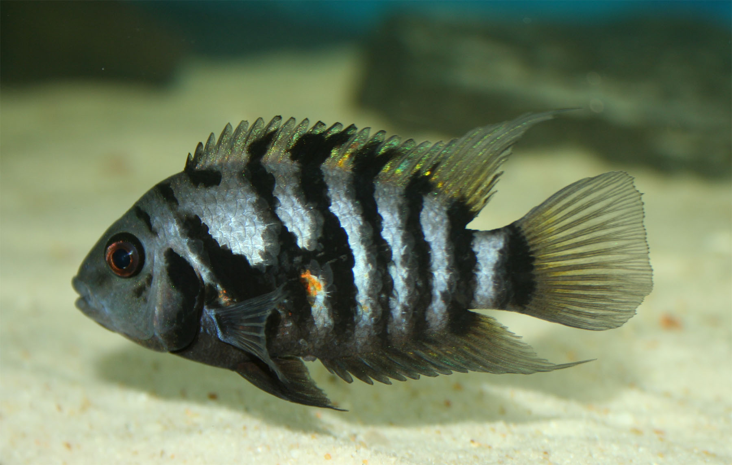
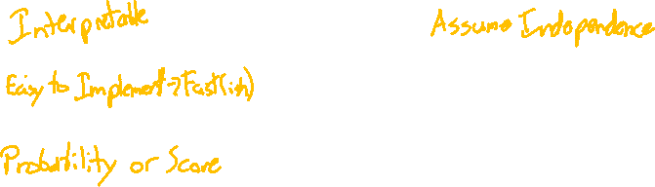
Naïve Bayes
Pro
Con

Slide 112
Naïve Bayes
Pro
Con
Works for non-binary cases
Can be run without training
Hard to implement for non-categorical data (without binning)

Slide 113

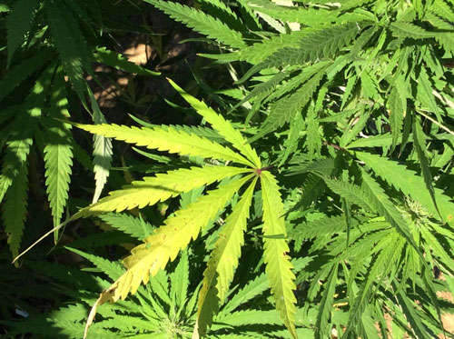
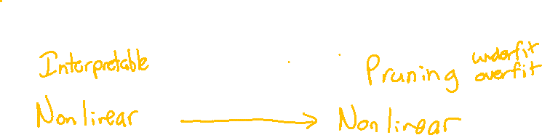
Decision Tree
Pro
Con (Ex)

Slide 114
Decision Tree
Pro
Con (Ex)
Easy to implement
Easy to follow
Easy(ish) to interpret
Prone to overfitting

Slide 115


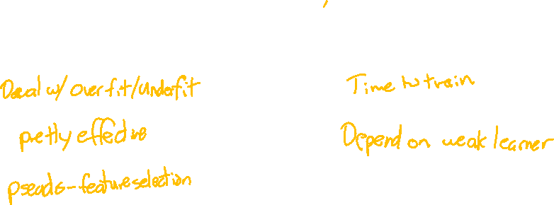
Decision Forest / Adaboost
Pro
Con

Slide 116
Decision Forest / Adaboost
Pro
Con (Ex)
Adaptive to difficult-to-classify cases
Difficult to interpret

Slide 117


Logistic Regression
Pro
Con

Slide 118
Logistic Regression
Pro
Con
Linear decision boundary
Binary only

Slide 119


Support Vector Machines
Pro
Con

Slide 120

Support Vector Machines
Pro
Con (Ex)
Linear decision boundary
Binary only

Slide 121

Next time…
Neural Networks!
Notes:
https://i.pinimg.com/originals/30/5e/08/305e0877c1ade71c70fcd4484aef2d2d.png

